Slide 1
Basic Business Statistics
11th Edition
Chapter 2
Presenting Data in Tables and Charts
Basic Business Statistics, 11e © 2009 Prentice-Hall, Inc.
Chap 2-<number>

Slide 2
Learning Objectives
In this chapter you learn:
To develop tables and charts for categorical data
To develop tables and charts for numerical data
The principles of properly presenting graphs
Basic Business Statistics, 11e © 2009 Prentice-Hall, Inc..
Chap 2-<number>

Slide 3
Categorical Data Are Summarized By Tables & Graphs
Categorical Data
Graphing Data
Tabulating Data
Summary Table
Bar Charts
Pie Charts
Pareto Diagram
Basic Business Statistics, 11e © 2009 Prentice-Hall, Inc..
Chap 2-<number>

Slide 4
Organizing Categorical Data: Summary Table
A summary table indicates the frequency, amount, or percentage of items in a set of categories so that you can see differences between categories.
Banking Preference? | Percent
ATM | 16%
Automated or live telephone | 2%
Drive-through service at branch | 17%
In person at branch | 41%
Internet | 24%
Basic Business Statistics, 11e © 2009 Prentice-Hall, Inc..
Chap 2-<number>

Slide 5
Bar and Pie Charts
Bar charts and Pie charts are often used for categorical data
Length of bar or size of pie slice shows the frequency or percentage for each category
Basic Business Statistics, 11e © 2009 Prentice-Hall, Inc..
Chap 2-<number>

Slide 6
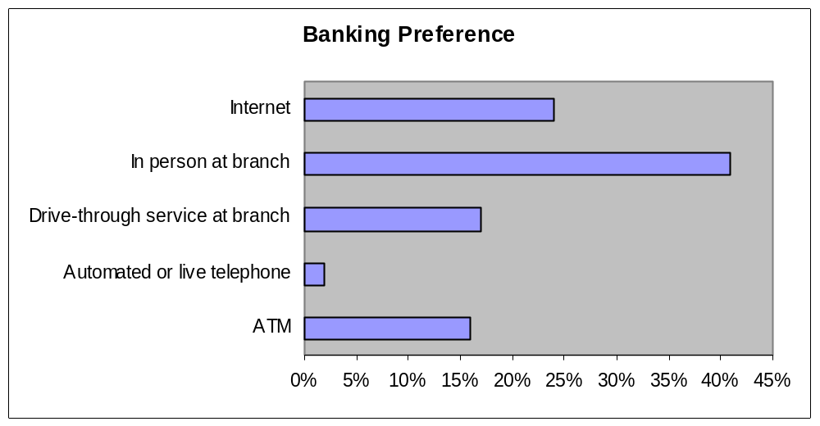
Organizing Categorical Data:
Bar Chart
In a bar chart, a bar shows each category, the length of which represents the amount, frequency or percentage of values falling into a category.
Basic Business Statistics, 11e © 2009 Prentice-Hall, Inc..
Chap 2-<number>

Slide 7
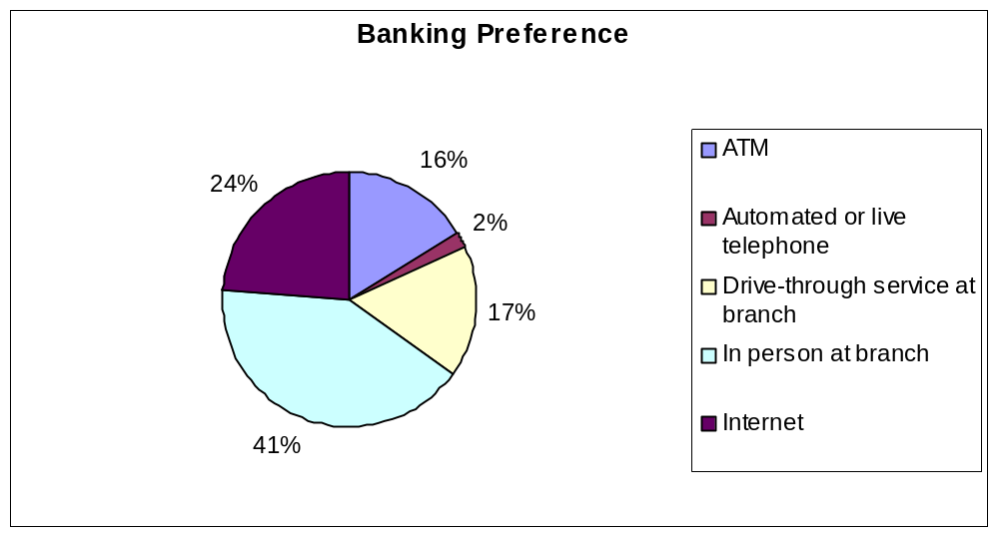
Organizing Categorical Data:
Pie Chart
The pie chart is a circle broken up into slices that represent categories. The size of each slice of the pie varies according to the percentage in each category.
Basic Business Statistics, 11e © 2009 Prentice-Hall, Inc..
Chap 2-<number>

Slide 8
Organizing Categorical Data:
Pareto Diagram
Used to portray categorical data (nominal scale)
A vertical bar chart, where categories are shown in descending order of frequency
A cumulative polygon is shown in the same graph
Used to separate the “vital few” from the “trivial many”
Basic Business Statistics, 11e © 2009 Prentice-Hall, Inc..
Chap 2-<number>

Slide 9
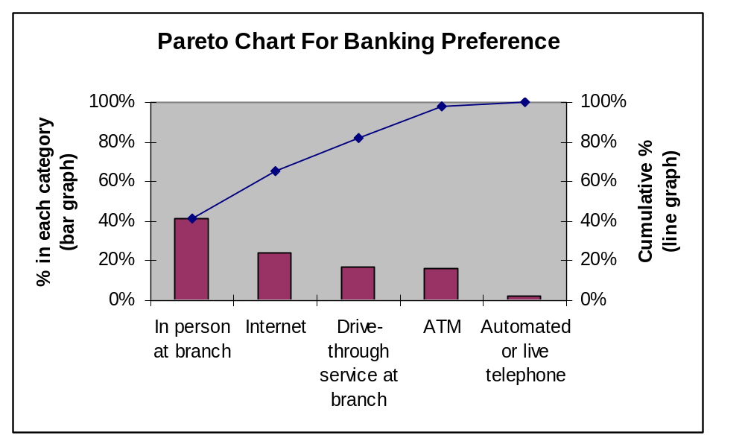
Organizing Categorical Data:
Pareto Diagram
Basic Business Statistics, 11e © 2009 Prentice-Hall, Inc..
Chap 2-<number>

Slide 10
Tables and Charts for
Numerical Data
Numerical Data
Frequency Distributions and
Cumulative Distributions
Ordered Array
Stem-and-Leaf
Display
Histogram
Polygon
Ogive
Basic Business Statistics, 11e © 2009 Prentice-Hall, Inc..
Chap 2-<number>

Slide 11
Organizing Numerical Data:
Ordered Array
An ordered array is a sequence of data, in rank order, from the smallest value to the largest value.
Shows range (minimum value to maximum value)
May help identify outliers (unusual observations)
Age of Surveyed College Students | Day Students
 | 16 | 17 | 17 | 18 | 18 | 18
 | 19 | 19 | 20 | 20 | 21 | 22
 | 22 | 25 | 27 | 32 | 38 | 42
 | Night Students
 | 18 | 18 | 19 | 19 | 20 | 21
 | 23 | 28 | 32 | 33 | 41 | 45
Basic Business Statistics, 11e © 2009 Prentice-Hall, Inc..
Chap 2-<number>

Slide 12
Stem-and-Leaf Display
A simple way to see how the data are distributed and where concentrations of data exist
  METHOD: Separate the sorted data series
  into leading digits (the stems) and
  the trailing digits (the leaves)
Basic Business Statistics, 11e © 2009 Prentice-Hall, Inc..
Chap 2-<number>

Slide 13
Organizing Numerical Data:
Stem and Leaf Display
A stem-and-leaf display organizes data into groups (called stems) so that the values within each group (the leaves) branch out to the right on each row.
Age of College Students
Day Students Night Students
Age of Surveyed College Students | Day Students
 | 16 | 17 | 17 | 18 | 18 | 18
 | 19 | 19 | 20 | 20 | 21 | 22
 | 22 | 25 | 27 | 32 | 38 | 42
 | Night Students
 | 18 | 18 | 19 | 19 | 20 | 21
 | 23 | 28 | 32 | 33 | 41 | 45
Stem | Leaf
1 | 67788899
2 | 0012257
3 | 28
4 | 2
Stem | Leaf
1 | 8899
2 | 0138
3 | 23
4 | 15
Basic Business Statistics, 11e © 2009 Prentice-Hall, Inc..
Chap 2-<number>

Slide 14
Organizing Numerical Data:
Frequency Distribution
The frequency distribution is a summary table in which the data are arranged into numerically ordered classes.
You must give attention to selecting the appropriate number of class groupings for the table, determining a suitable width of a class grouping, and establishing the boundaries of each class grouping to avoid overlapping.
The number of classes depends on the number of values in the data. With a larger number of values, typically there are more classes. In general, a frequency distribution should have at least 5 but no more than 15 classes.
To determine the width of a class interval, you divide the range (Highest value–Lowest value) of the data by the number of class groupings desired.
Basic Business Statistics, 11e © 2009 Prentice-Hall, Inc..
Chap 2-<number>

Slide 15
Organizing Numerical Data:
Frequency Distribution Example
Example: A manufacturer of insulation randomly selects 20 winter days and records the daily high temperature
24, 35, 17, 21, 24, 37, 26, 46, 58, 30, 32, 13, 12, 38, 41, 43, 44, 27, 53, 27
Basic Business Statistics, 11e © 2009 Prentice-Hall, Inc..
Chap 2-<number>

Slide 16
Organizing Numerical Data:
Frequency Distribution Example
Sort raw data in ascending order:
12, 13, 17, 21, 24, 24, 26, 27, 27, 30, 32, 35, 37, 38, 41, 43, 44, 46, 53, 58
Find range: 58 - 12 = 46
Select number of classes: 5 (usually between 5 and 15)
Compute class interval (width): 10 (46/5 then round up)
Determine class boundaries (limits):
    Class 1: 10 to less than 20
    Class 2: 20 to less than 30
    Class 3: 30 to less than 40
    Class 4: 40 to less than 50
    Class 5: 50 to less than 60
Compute class midpoints: 15, 25, 35, 45, 55
Count observations & assign to classes
Basic Business Statistics, 11e © 2009 Prentice-Hall, Inc..
Chap 2-<number>

Slide 17
Organizing Numerical Data:
Frequency Distribution Example
Data in ordered array:
12, 13, 17, 21, 24, 24, 26, 27, 27, 30, 32, 35, 37, 38, 41, 43, 44, 46, 53, 58
Relative
Frequency
Class Frequency
Percentage
10 but less than 20 3 .15 15
20 but less than 30 6 .30 30
30 but less than 40 5 .25 25
40 but less than 50 4 .20 20
50 but less than 60 2 .10 10
Total 20 1.00 100
Basic Business Statistics, 11e © 2009 Prentice-Hall, Inc..
Chap 2-<number>

Slide 18
Tabulating Numerical Data:
Cumulative Frequency
Data in ordered array:
12, 13, 17, 21, 24, 24, 26, 27, 27, 30, 32, 35, 37, 38, 41, 43, 44, 46, 53, 58
Cumulative Frequency
Cumulative Percentage
Class
Frequency
Percentage
10 but less than 20 3 15 3 15
20 but less than 30 6 30 9 45
30 but less than 40 5 25 14 70
40 but less than 50 4 20 18 90
50 but less than 60 2 10 20 100
Total 20 100
Basic Business Statistics, 11e © 2009 Prentice-Hall, Inc..
Chap 2-<number>

Slide 19
Why Use a Frequency Distribution?
It condenses the raw data into a more useful form
It allows for a quick visual interpretation of the data
It enables the determination of the major characteristics of the data set including where the data are concentrated / clustered
Basic Business Statistics, 11e © 2009 Prentice-Hall, Inc..
Chap 2-<number>

Slide 20
Frequency Distributions:
Some Tips
Different class boundaries may provide different pictures for the same data (especially for smaller data sets)
Shifts in data concentration may show up when different class boundaries are chosen
As the size of the data set increases, the impact of alterations in the selection of class boundaries is greatly reduced
When comparing two or more groups with different sample sizes, you must use either a relative frequency or a percentage distribution
Basic Business Statistics, 11e © 2009 Prentice-Hall, Inc..
Chap 2-<number>

Slide 21
Organizing Numerical Data:
The Histogram
A vertical bar chart of the data in a frequency distribution is called a histogram.
In a histogram there are no gaps between adjacent bars.
The class boundaries (or class midpoints) are shown on the horizontal axis.
The vertical axis is either frequency, relative frequency, or percentage.
The height of the bars represent the frequency, relative frequency, or percentage.
Basic Business Statistics, 11e © 2009 Prentice-Hall, Inc..
Chap 2-<number>

Slide 22
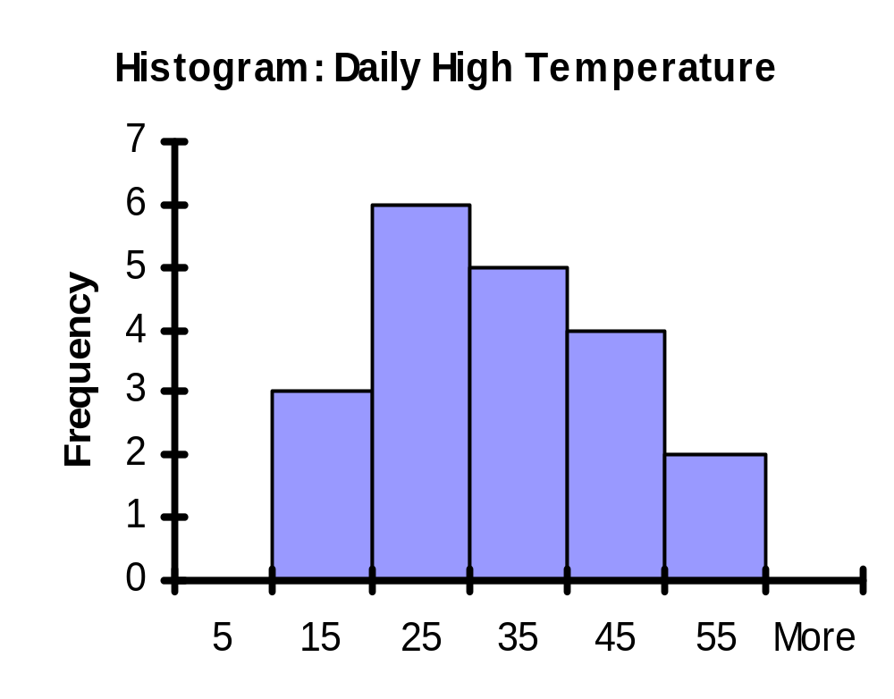
Organizing Numerical Data:
The Histogram
Relative
Frequency
Percentage
Class Frequency
10 but less than 20 3 .15 15
20 but less than 30 6 .30 30
30 but less than 40 5 .25 25
40 but less than 50 4 .20 20
50 but less than 60 2 .10 10
Total 20 1.00 100
(In a percentage histogram the vertical axis would be defined to show the percentage of observations per class)
Basic Business Statistics, 11e © 2009 Prentice-Hall, Inc..
Chap 2-<number>

Slide 23
Organizing Numerical Data:
The Polygon
A percentage polygon is formed by having the midpoint of each class represent the data in that class and then connecting the sequence of midpoints at their respective class percentages.
The cumulative percentage polygon, or ogive, displays the variable of interest along the X axis, and the cumulative percentages along the Y axis.
Useful when there are two or more groups to compare.
Basic Business Statistics, 11e © 2009 Prentice-Hall, Inc..
Chap 2-<number>

Slide 24
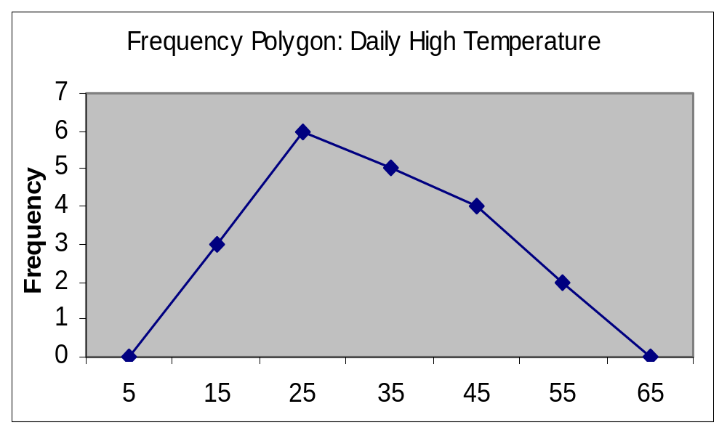
Graphing Numerical Data:
The Frequency Polygon
Class Midpoint
Class
Frequency
10 but less than 20 15 3
20 but less than 30 25 6
30 but less than 40 35 5
40 but less than 50 45 4
50 but less than 60 55 2
(In a percentage polygon the vertical axis would be defined to show the percentage of observations per class)
Class Midpoints
Basic Business Statistics, 11e © 2009 Prentice-Hall, Inc..
Chap 2-<number>

Slide 25
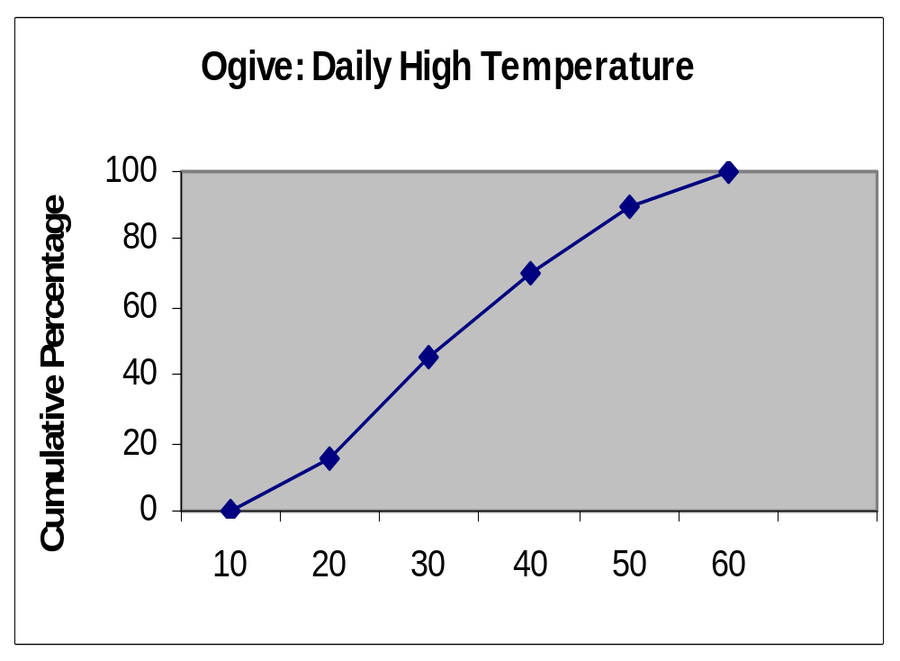

Graphing Cumulative Frequencies:
The Ogive (Cumulative % Polygon)
Lower class boundary
% less
than lower
boundary
Class
10 but less than 20 10 15
20 but less than 30 20 45
30 but less than 40 30 70
40 but less than 50 40 90
50 but less than 60 50 100
(In an ogive the percentage of the observations less than each lower class boundary are plotted versus the lower class boundaries.
Lower Class Boundary
Basic Business Statistics, 11e © 2009 Prentice-Hall, Inc..
Chap 2-<number>

Slide 26
Cross Tabulations
Used to study patterns that may exist between two or more categorical variables.
Cross tabulations can be presented in:
  Tabular form -- Contingency Tables
  Graphical form -- Side by Side Charts
Basic Business Statistics, 11e © 2009 Prentice-Hall, Inc..
Chap 2-<number>

Slide 27
Cross Tabulations:
The Contingency Table
A cross-classification (or contingency) table presents the results of two categorical variables. The joint responses are classified so that the categories of one variable are located in the rows and the categories of the other variable are located in the columns.
The cell is the intersection of the row and column and the value in the cell represents the data corresponding to that specific pairing of row and column categories.
A useful way to visually display the results of cross-classification data is by constructing a side-by-side bar chart.
Basic Business Statistics, 11e © 2009 Prentice-Hall, Inc..
Chap 2-<number>

Slide 28
Cross Tabulations:
The Contingency Table
A survey was conducted to study the importance of brand
name to consumers as compared to a few years ago. The
results, classified by gender, were as follows:
Importance of Brand Name | Male | Female | Total
More | 450 | 300 | 750
Equal or Less | 3300 | 3450 | 6750
Total | 3750 | 3750 | 7500
Basic Business Statistics, 11e © 2009 Prentice-Hall, Inc..
Chap 2-<number>

Slide 29
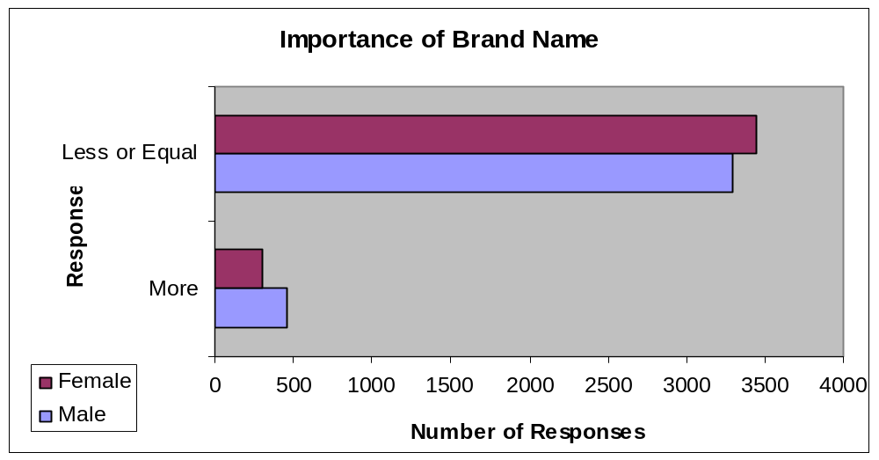
Cross Tabulations:
Side-By-Side Bar Charts
Basic Business Statistics, 11e © 2009 Prentice-Hall, Inc..
Chap 2-<number>

Slide 30
Scatter Plots
Scatter plots are used for numerical data consisting of paired observations taken from two numerical variables
One variable is measured on the vertical axis and the other variable is measured on the horizontal axis
Scatter plots are used to examine possible relationships between two numerical variables
Basic Business Statistics, 11e © 2009 Prentice-Hall, Inc..
Chap 2-<number>

Slide 31
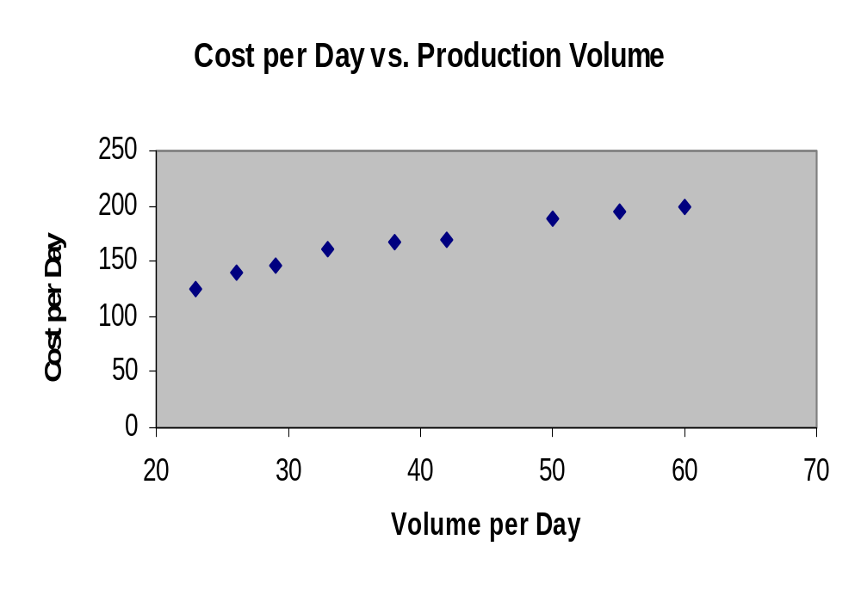
Scatter Plot Example
Volume per day | Cost per day
23 | 125
26 | 140
29 | 146
33 | 160
38 | 167
42 | 170
50 | 188
55 | 195
60 | 200
Basic Business Statistics, 11e © 2009 Prentice-Hall, Inc..
Chap 2-<number>

Slide 32
Time Series Plot
A Time Series Plot is used to study patterns in the values of a numeric variable over time
The Time Series Plot:
  Numeric variable is measured on the vertical axis and the time period is measured on the horizontal axis
Basic Business Statistics, 11e © 2009 Prentice-Hall, Inc..
Chap 2-<number>

Slide 33
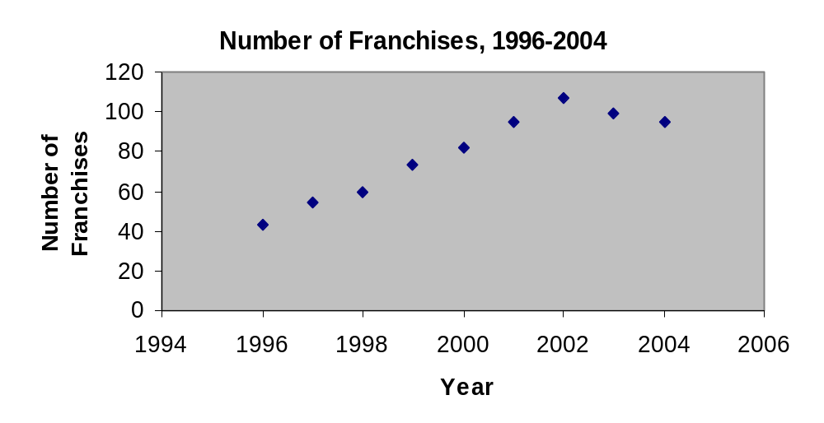
Time Series Plot Example
Year | Number of Franchises
1996 | 43
1997 | 54
1998 | 60
1999 | 73
2000 | 82
2001 | 95
2002 | 107
2003 | 99
2004 | 95
Basic Business Statistics, 11e © 2009 Prentice-Hall, Inc..
Chap 2-<number>

Slide 34
Principles of Excellent Graphs
The graph should not distort the data.
The graph should not contain unnecessary adornments (sometimes referred to as chart junk).
The scale on the vertical axis should begin at zero.
All axes should be properly labeled.
The graph should contain a title.
The simplest possible graph should be used for a given set of data.
Basic Business Statistics, 11e © 2009 Prentice-Hall, Inc..
Chap 2-<number>

Slide 35

Graphical Errors: Chart Junk
✓
Bad Presentation
Good Presentation
Minimum Wage
Minimum Wage
$
1960: $1.00
4
1970: $1.60
2
1980: $3.10
0
1990: $3.80
1960
1970
1980
1990
Basic Business Statistics, 11e © 2009 Prentice-Hall, Inc..
Chap 2-<number>

Slide 36
Graphical Errors:
No Relative Basis
Bad Presentation
✓
Good Presentation
A’s received by students.
A’s received by students.
Freq.
%
300
30%
200
20%
100
10%
0
0%
FR
SO
JR
SR
FR
SO
JR
SR
FR = Freshmen, SO = Sophomore, JR = Junior, SR = Senior
Basic Business Statistics, 11e © 2009 Prentice-Hall, Inc..
Chap 2-<number>

Slide 37
Graphical Errors:
Compressing the Vertical Axis
✓
Bad Presentation
Good Presentation
Quarterly Sales
Quarterly Sales
$
$
200
50
100
25
0
0
Q1
Q2
Q3
Q4
Q1
Q2
Q3
Q4
Basic Business Statistics, 11e © 2009 Prentice-Hall, Inc..
Chap 2-<number>

Slide 38
Graphical Errors: No Zero Point on the Vertical Axis
Bad Presentation
✓
Good Presentations
Monthly Sales
$
Monthly Sales
$
45
45
42
42
39
39
36
36
0
J
F
M
A
M
J
J
F
M
A
M
J
Graphing the first six months of sales
Basic Business Statistics, 11e © 2009 Prentice-Hall, Inc..
Chap 2-<number>

Slide 39
Chapter Summary
In this chapter, we have
Organized categorical data using the summary table, bar chart, pie chart, and Pareto diagram.
Organized numerical data using the ordered array, stem-and-leaf display, frequency distribution, histogram, polygon, and ogive.
Examined cross tabulated data using the contingency table and side-by-side bar chart.
Developed scatter plots and time series graphs.
Examined the do’s and don'ts of graphically displaying data.
Basic Business Statistics, 11e © 2009 Prentice-Hall, Inc..
Chap 2-<number>

